Slide 1

Chapter 6
Rate-of-Return Analysis
收益率分析

Slide 2
Main contents
Part 1
Part 2
Part 3
Part 4
Definition of
a rate of return
Calculation of
a rate of
return (难点）
An internal
rate-of-return
criterion
Incremental
analysis
增量分析 (重点)

Slide 3

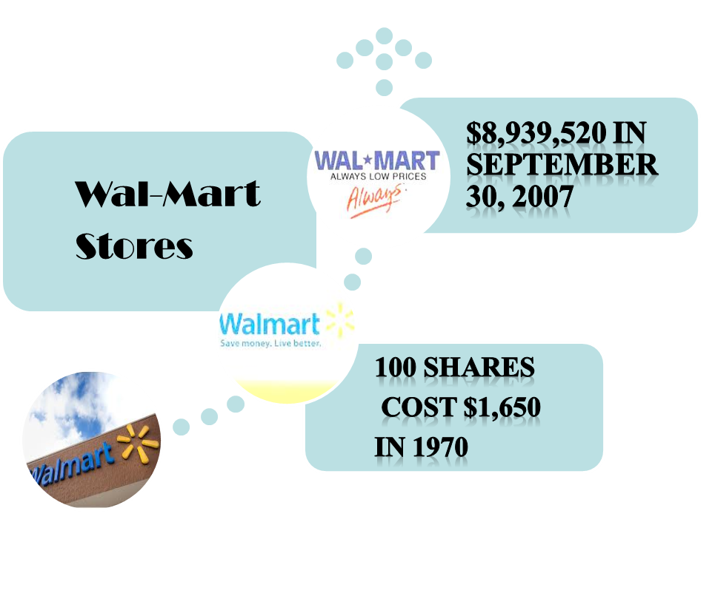
What is the rate of return on that investment?

Slide 4
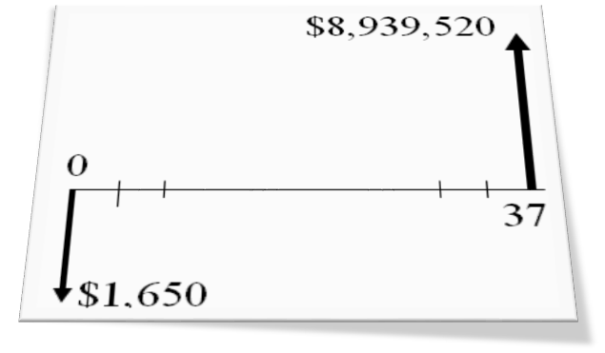

Given: P = $1,650
F = $8,939,520
N = 37
Find i:
$8,939,520 = $1,650 (1 + i )³⁷
i = 26.16%
Rate of Return

Slide 5
1. Rate of Return
Definition: A relative percentage method which measures the yield as a percentage of investment over the life of a project
Other different terms: internal rate of return内部收益率, marginal efficiency of capital边际资本收益, yield to maturity到期收益率, discount rate贴现率 , interest rate.

Slide 6
Return on Investment – Definition 1： this definition is based on a typical loan transaction
Definition 1: Rate of return (ROR) is defined as the interest rate earned on the unpaid balance of an amortized loan.
Example: A bank lends $10,000 and receives annual payment of $4,021 over 3 years. The bank is said to earn a return of 10% on its loan of $10,000.
$10000=$4021(P/A,i,3)

Slide 7
Return on Invested Capital– Definition 2 this definition is based on the project cash-flow series
Definition 3: The internal rate of return is the interest rate charged on the unrecovered project balance of the investment such that, when the project terminates, the unrecovered project balance is zero.
Example: A company invests $10,000 in a computer with a three-year useful life and equivalent annual labor savings of $4,021.

Slide 8
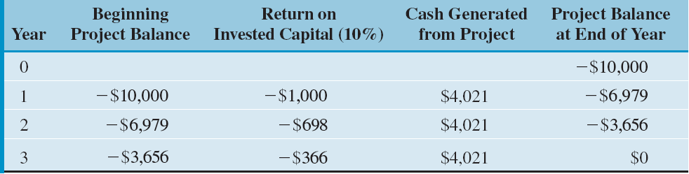
Project Balance
We see that 10% is earned (or charged) on $10,000 during year one,
10% is earned on $6,979 during year two, and 10% is earned during
year three. Or, the firm earns a 10% rate of return on funds that remain
internally invested in the project.

Slide 9
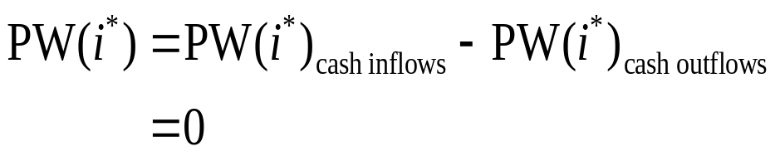
Rate of Return – Definition 3 this definition is on the mathematical expressions of the present-worth function
Definition: Rate of return (ROR) is the break-even interest rate, i*, at which the net present worth of a project is zero.
Mathematical Relation:

Slide 10
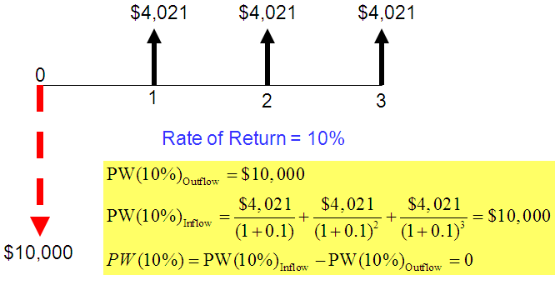
Reconsider the loan transaction

Slide 11
2. Methods for Finding Rate of Return
Direct Solution Method
Trial-and-Error Method
Using Excel’s Financial Command

Slide 12
Simple versus Non-simple Investments
Simple investment
  An investment in which the initial cash flows are negative and only one sign change occurs in the net cash flow series – a unique rate of return
Non-simple investment
  An investment in which the initial cash flows are negative and more than one sign change occurs in the net cash flow series – a possibility of having more than one rate of return
Note: We ignore a zero cash flow in determining the change.

Slide 13
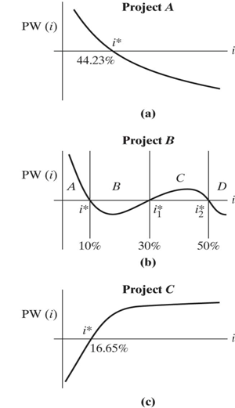
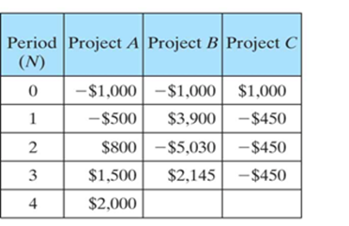

Investment Classification
Example 7.1

Slide 14
Finding i* by Direct Solution:
Example 7.2
n | Project 1 | Project 2
0 | -$3,000 | -$2,000
1 | 0 | $1,300
2 | 0 | $1,500
3 | 0
4 | $4,500

Slide 15
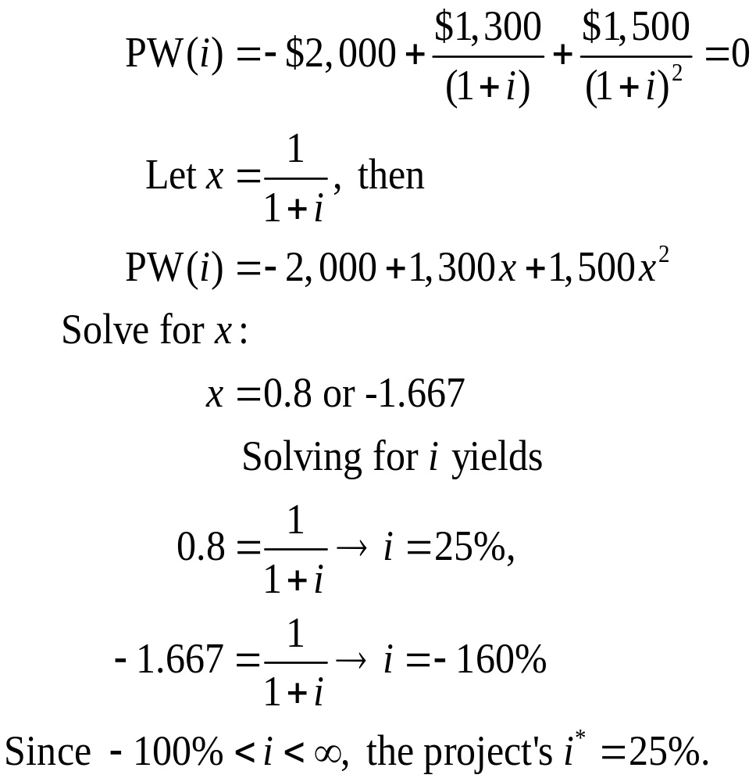
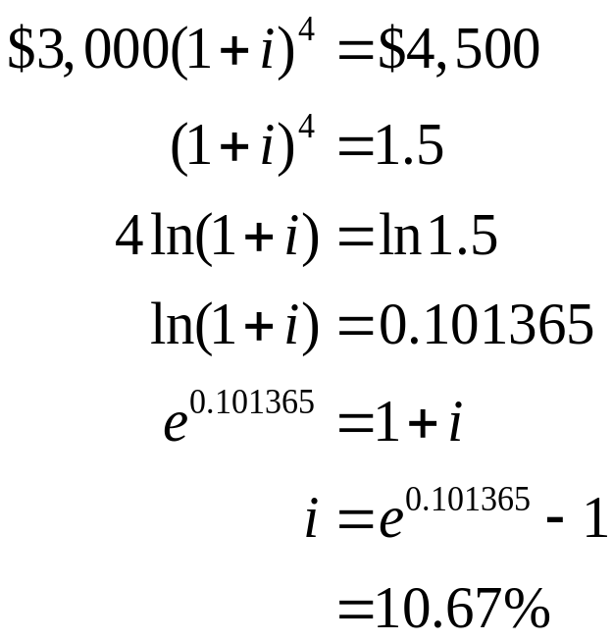
Solution:
Project 1
Project 2

Slide 16
Finding i* by Trial and Error
Example 7.3
$55,760
n | Cash Flow
0 | -$75,000
1 | 24,400
2 | 27,340
3 | 55,760
$27,340
$24,400
0
1
2
3
$75,000

Slide 17
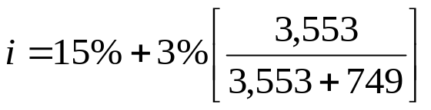

Solution:
Step 4: If you bracket the
solution, you use a linear
interpolation to approximate the solution.
Step 1: Guess an interest
rate, say, i = 15%
Step 2: Compute PW(i)
at the guessed i value.
PW (15%) = $3,553
Step 3: If PW(i) > 0, then
increase i.
If PW(i) < 0,
then decrease i.
PW(18%) = -$749
3,553
0
-749
15%
i
18%

Slide 18
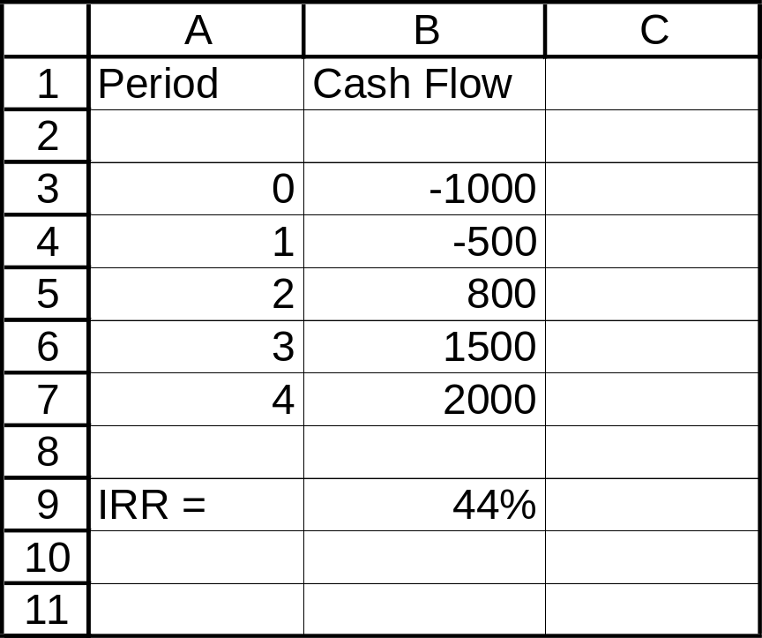
Finding Rate of Return on Excel
Example 7.4
Period (n) | Cash Flow
0 | -$1,000
1 | -500
2 | 800
3 | 1,500
4 | 2,000
=IRR(B3:B7,10%)
Cell range
Initial guess

Slide 19
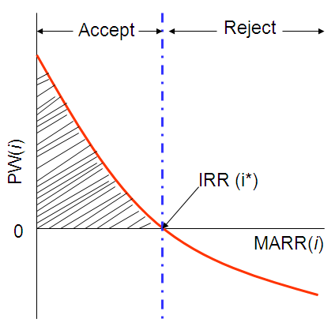
3. Internal-Rate-of-return criterion
Relationship to the PW Analysis
PW Analysis:
If PW(i) > 0, accept, where i is MARR.
ROR Analysis:
  If IRR > MARR, accept

Slide 20
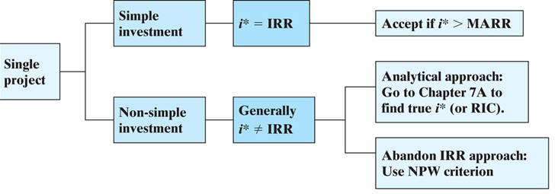
Project Selection Rules under the IRR Criterion

Slide 21
7.3.1 Decision Rule for Simple Investment
A unique ROR
  IRR = i*
Decision Rule:
  If IRR > MARR, Accept
  If IRR = MARR, Indifferent
  If IRR < MARR, Reject
IRR > MARR
IRR < MARR
i* = IRR
PW(i)
0
i*

Slide 22
Example 7.5
Simple Investment
Capital investment required: $1,250,000
Project life: 15 years
Salvage value of the wind turbines after 15 years: $80,000
Annual net cash flows (after all deductions): $731,500
$731,500+80,000
A = $731,500
0
1 2 3 4 ……..
15
What is the projected IRR on this investment?
if MARR is known to be 18%, is this investment justifiable?
$1,250,000

Slide 23
Solution:
PW (i)=
-1250000+731,500(P/A,I,15)+80,000(P/F,I,15)=0
IRR=58.46%

Slide 24
7.3.2 Decision Rules for Nonsimple Investment
A possibility of multiple RORs.
If the PW (i) plot looks like this, then, IRR = i*.
If IRR > MARR, Accept
If the PW(i) plot looks like this, then, IRR ≠ i*.
  Find the true IRR by using the procedures in Appendix 7A or,
  Abandon the IRR method and use the PW method.
PW (i)
i*
i
PW (i)
i*
i*
i

Slide 25
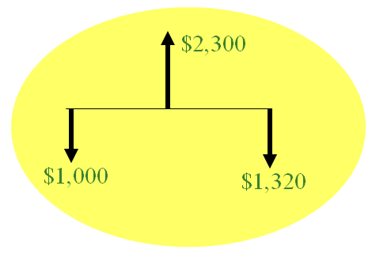
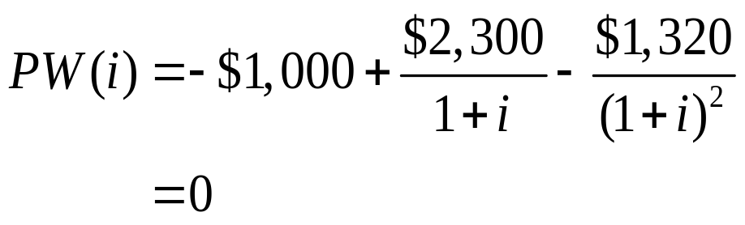
Turbo Image Processing’s Investment Decision
Problem
Example 7.6
Find the rate(s) of return:

Slide 26
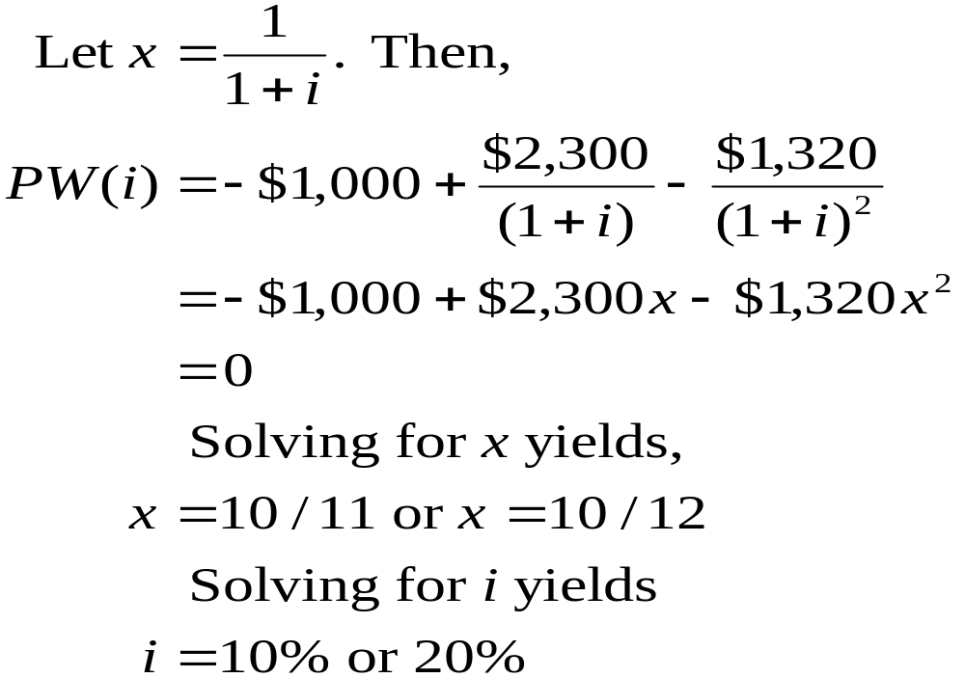
Calculating i*s

Slide 27
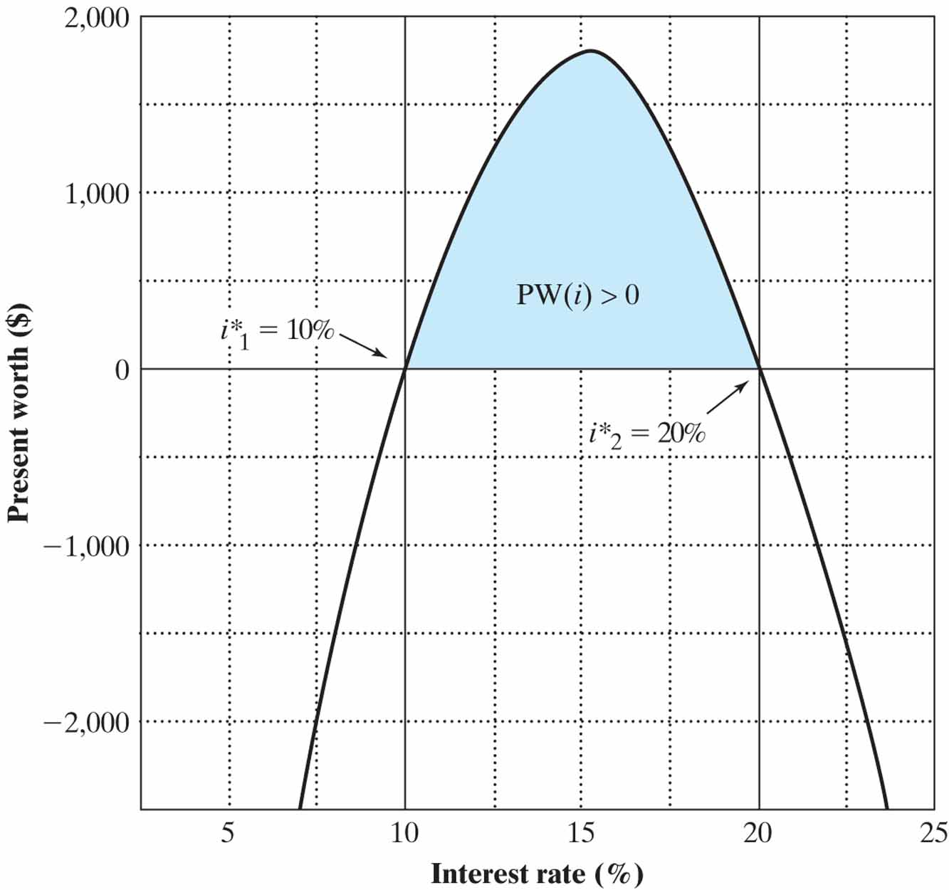
NPW Plot for a Nonsimple Investment with Multiple Rates of Return
Conclusion: hard to find the true IRR from 10% and 20%

Slide 28
How to Proceed?
Note: If you encounter multiple rates of return, abandon the IRR analysis and use the PW criterion.
At MARR = 15%
PW(15%) = -$1,000 + $2,300 (P/F, 15%, 1)
- $1,320 (P/F, 15%, 2 )
= $1.89 > 0
Accept the investment

Slide 29
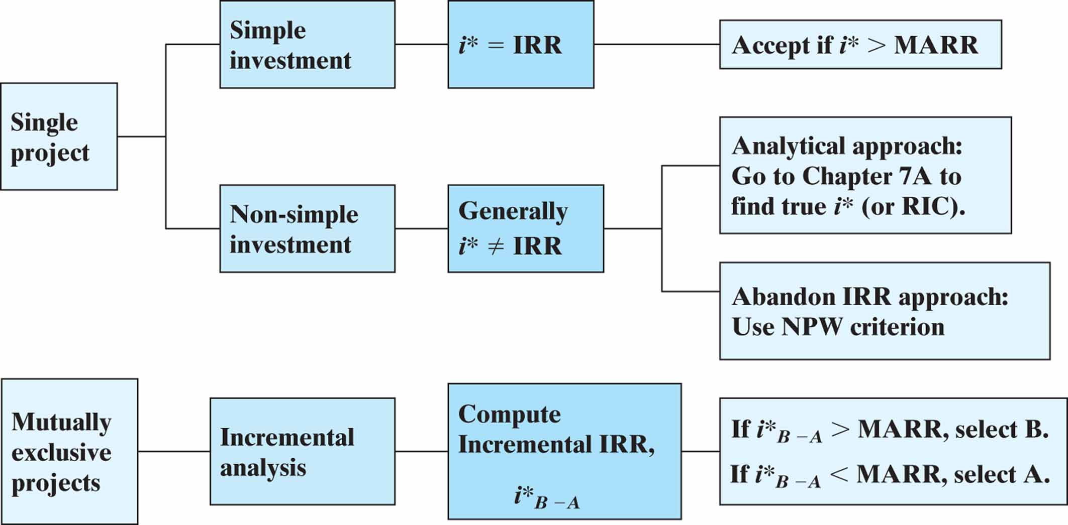
Project Selection Rules under the IRR Criterion
增量分析

Slide 30
4. Incremental Analysis ---Comparing Mutually Exclusive Alternatives
Flaws in Project Ranking by IRR
Issue: Can we rank the mutually exclusive projects by the magnitude of its IRR?
n A1 A2
0
1
IRR
-$1,000 -$5,000
$2,000 $7,000
100% > 40%
$818 < $1,364
PW (10%)

Slide 31
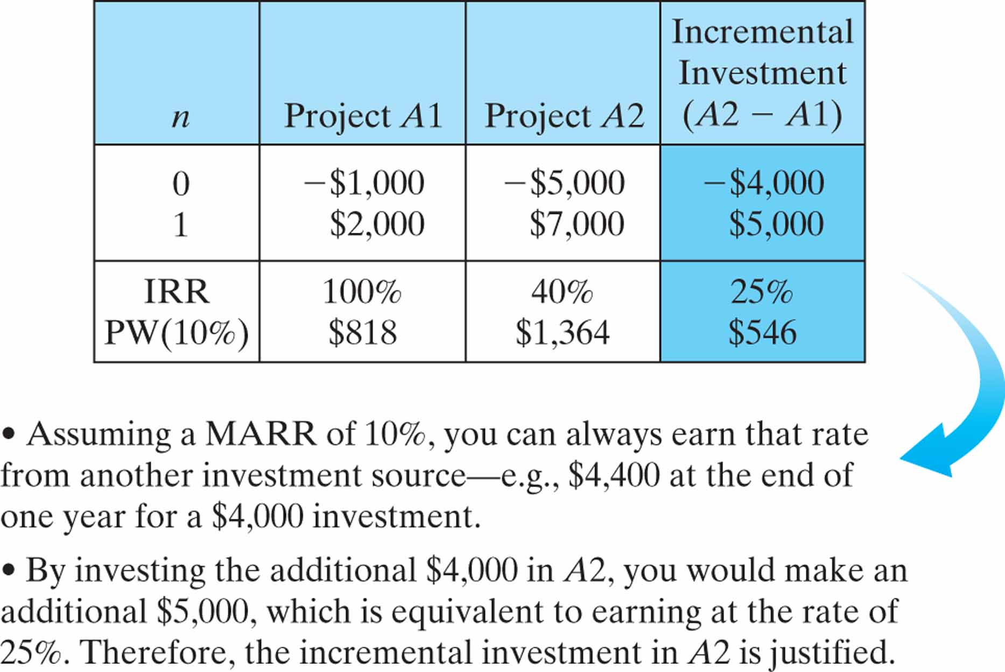
Illustration of Incremental Analysis

Slide 32
Incremental Analysis (Procedure)
Step 1: Compute the cash flows for the difference between the projects (A,B) by subtracting the cash
flow of the lower investment cost project (A) from
that of the higher investment cost project (B).
Step 2: Compute the IRR on this incremental investment (IRR).
Step 3: Accept the investment B if and only if
IRR _{B-A} > MARR _{B-A}
NOTE: Make sure that both IRR_{A} and IRR_{B} are greater than MARR.

Slide 33
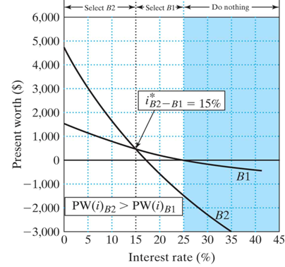
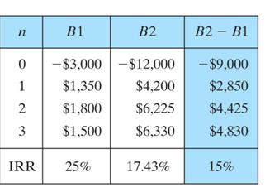

IRR on Incremental Investment:
Two Alternatives
Example 7.7

Slide 34
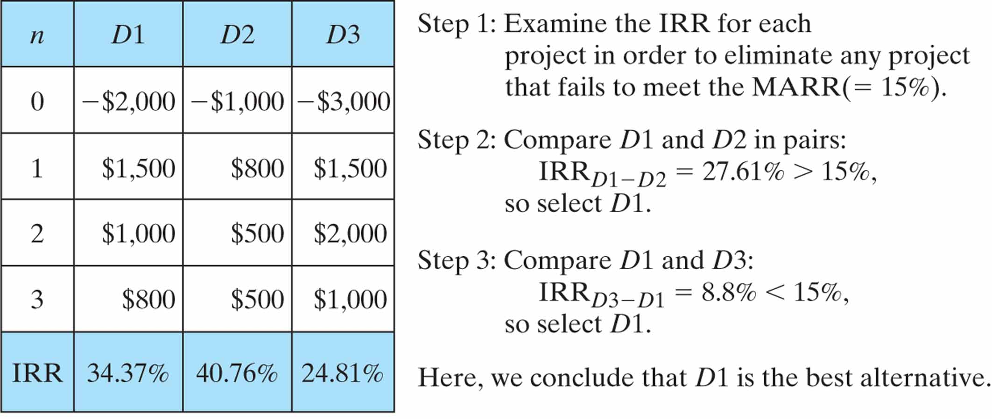
IRR on Incremental Investment:
Three Alternatives
Example 7.8
MARR=15%

Slide 35
Incremental Analysis for Cost-Only Projects
Example 7.9
Falk Corporation is considering two types of manufacturing systems to produce its shaft couplings over years: CMS and FMS. The average number of pieces to be produced on either system would be 544,000 per year. Operating costs, initial investment, and salvage value for each alternatives are estimated as follows:
MARR=15%， which alternative would be a better choice?

Slide 36
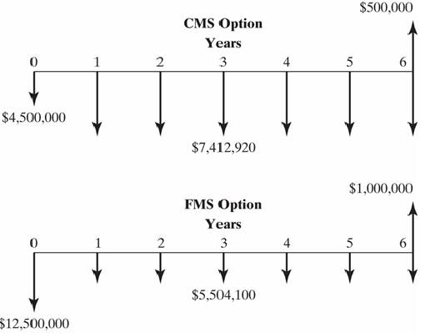

Slide 37
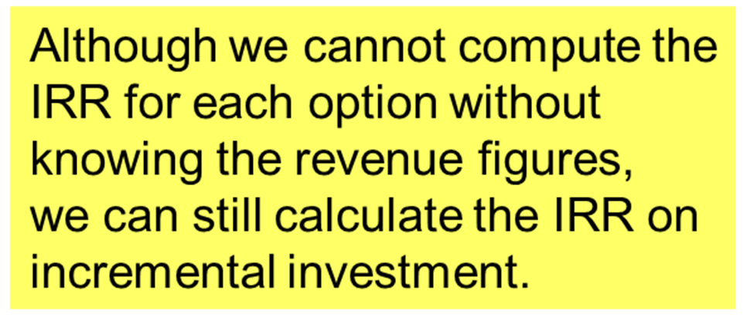
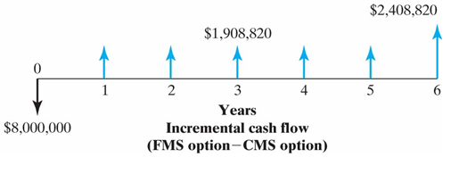
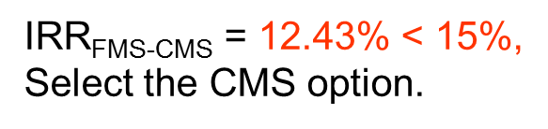

Slide 38
NOTE: We don’t encourage you to use the IRR approach to compare projects with unequal lives.

Slide 39
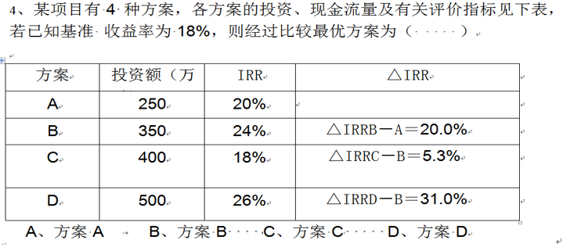
Practice question 1

Slide 40
Practice question 2
1. The following information on four mutually exclusive projects is given here.
All four simple projects have the same service. Support the information about incremental rates of return between projects are:
IRR (B-A)=85% IRR (D-C)=25%
IRR (B-C)=30% IRR (A-D)=50%
Which project would you choose based on the rate-of-return criterion at a MARR of 29%?

Slide 41
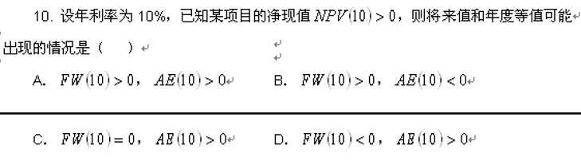
Practice question 3

Slide 42
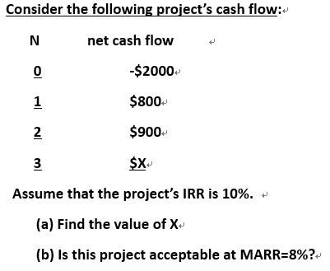
Practice question 4

Slide 43
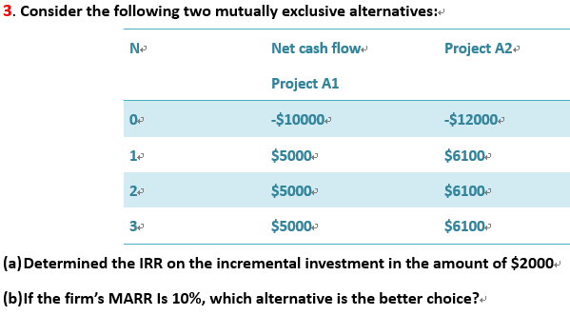
Practice question 5

Slide 44
Summary
Rate of return is the interest rate earned on unrecovered project balances. It is an intuitively familiar and understandable measure of project profitability.
We can determine the rate of return for a given project’s cash flow series by identifying an interest rate that equates the PW if its cash flows to zero.

Slide 45
3 ways to determine rate of return
To apply rate of return analysis, we need to distinguish a simple investment from a non-simple investment.
For a simple investment: compare IRR with MARR
To compare 2 or more alternatives, incremental investment must be used.

Slide 46

Question: We’ve known how to use given cash flows to make evaluations, while how to find these cash flows?

